Slide 1
QGIS
Geometry Generator
Simbología a partir de expresiones
Por: Evelio Madera A

Slide 2
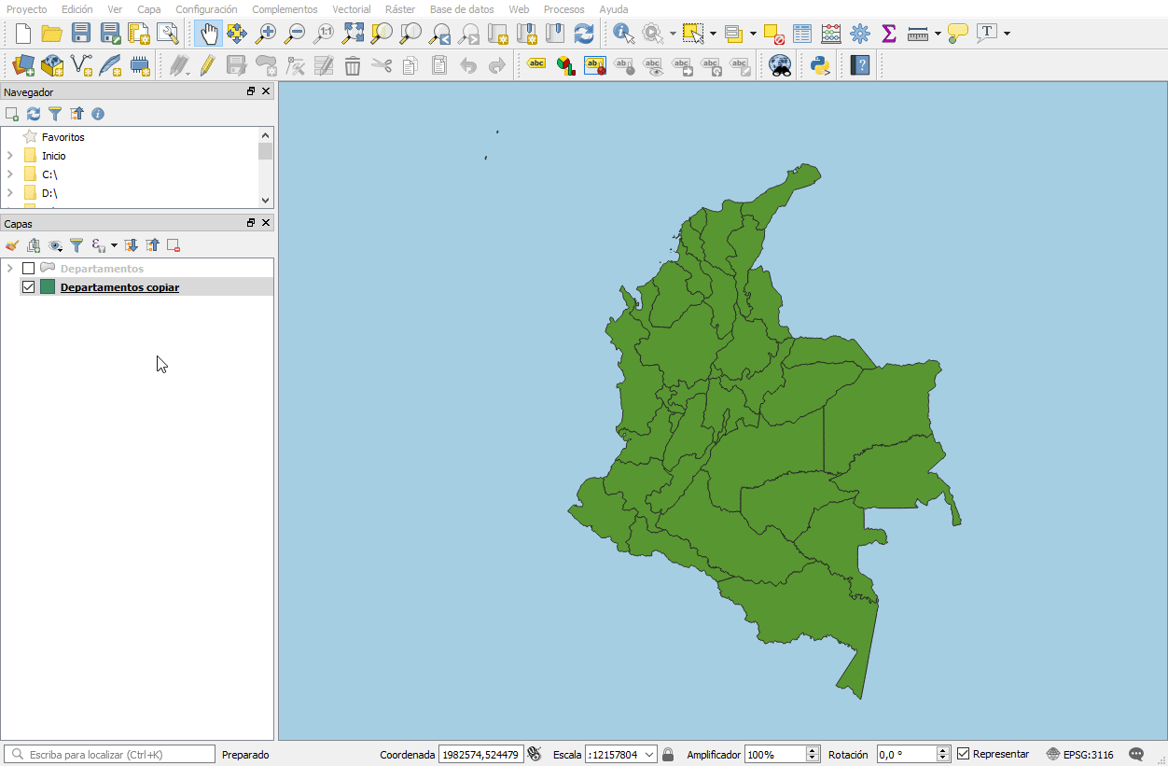
QGIS | Geometry Generator (GG)
Polígonos
Líneas
Puntos
Capa ⇒ Propiedades ⇒ Simbología

Slide 3
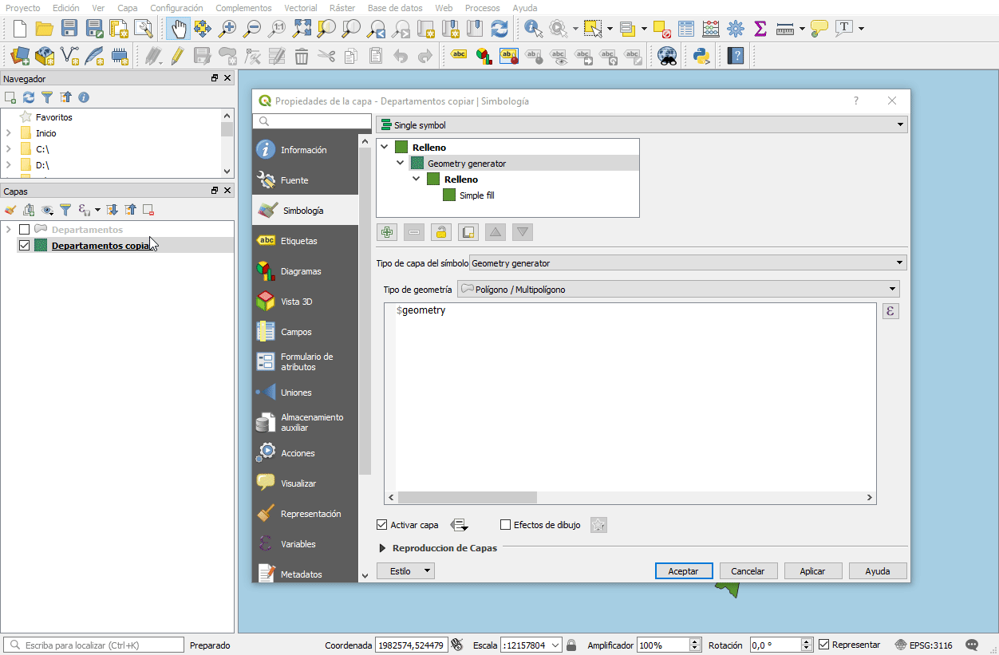
QGIS | Geometry Generator (GG)
Crear
Consultar
Transformar
Trasladar
Proyectar
No rotar
Diálogo de expresiones ⇒ Geometría

Slide 4
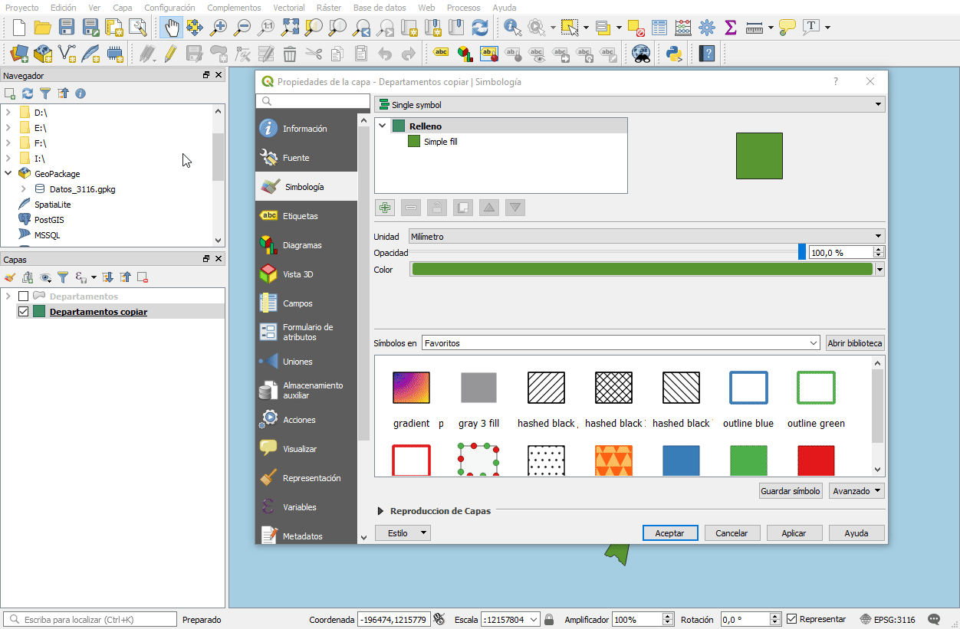
GG | Centroides
centroid( $geometry)

Slide 5
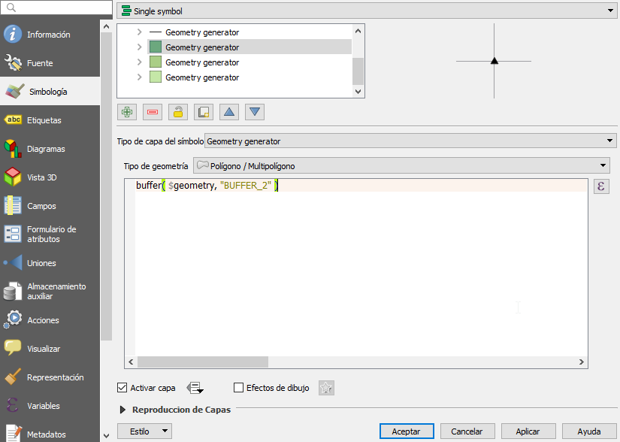
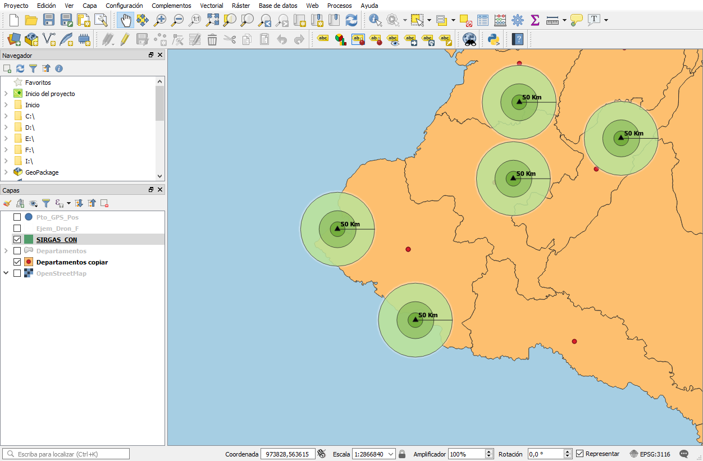
GG | Buffer
buffer ( $geometry, “BUFFER_2”)

Slide 6
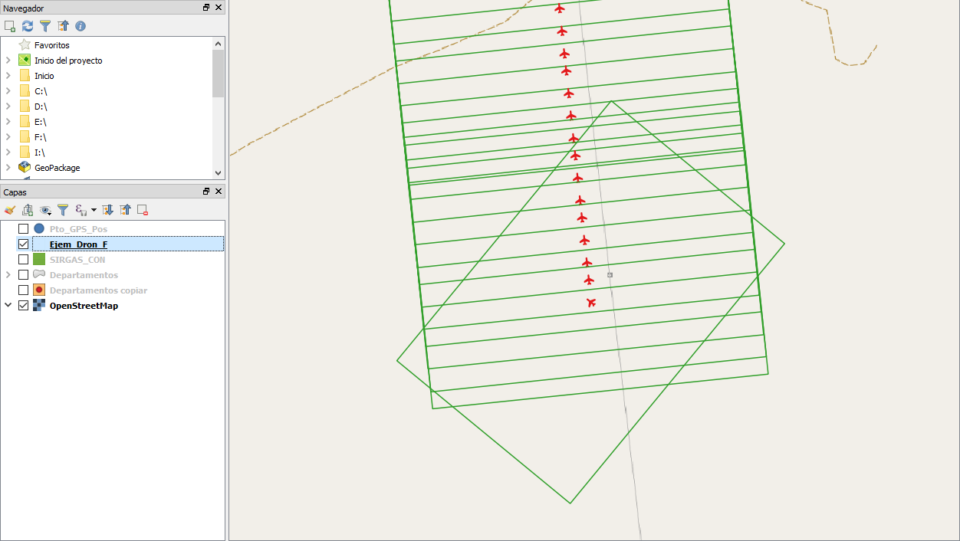
GG | Punto ⇒ Líneas ⇒ Polígonos
make_polygon( make_line( project( $geometry , "DIAG",radians(56.3099+ "Yaw" ) ), project( $geometry , "DIAG",radians(123.6901+ "Yaw" ) ),project( $geometry , "DIAG",radians(236.3099+ "Yaw" ) ),project( $geometry , "DIAG",radians(303.6901+ "Yaw" ) ),project( $geometry , "DIAG",radians(56.3099+ "Yaw" ) )))

Slide 7
Referencias consultadas
https://anitagraser.com/2017/04/08/a-guide-to-geometry-generator-symbol-layers/
https://gis.stackexchange.com/questions/194519/using-qgis-geometry-generator-to-get-rectangle-from-point
https://gis.stackexchange.com/questions/282951/create-a-line-label-from-centroid-to-edge-of-circle-with-geometry-generator

